Slide 1
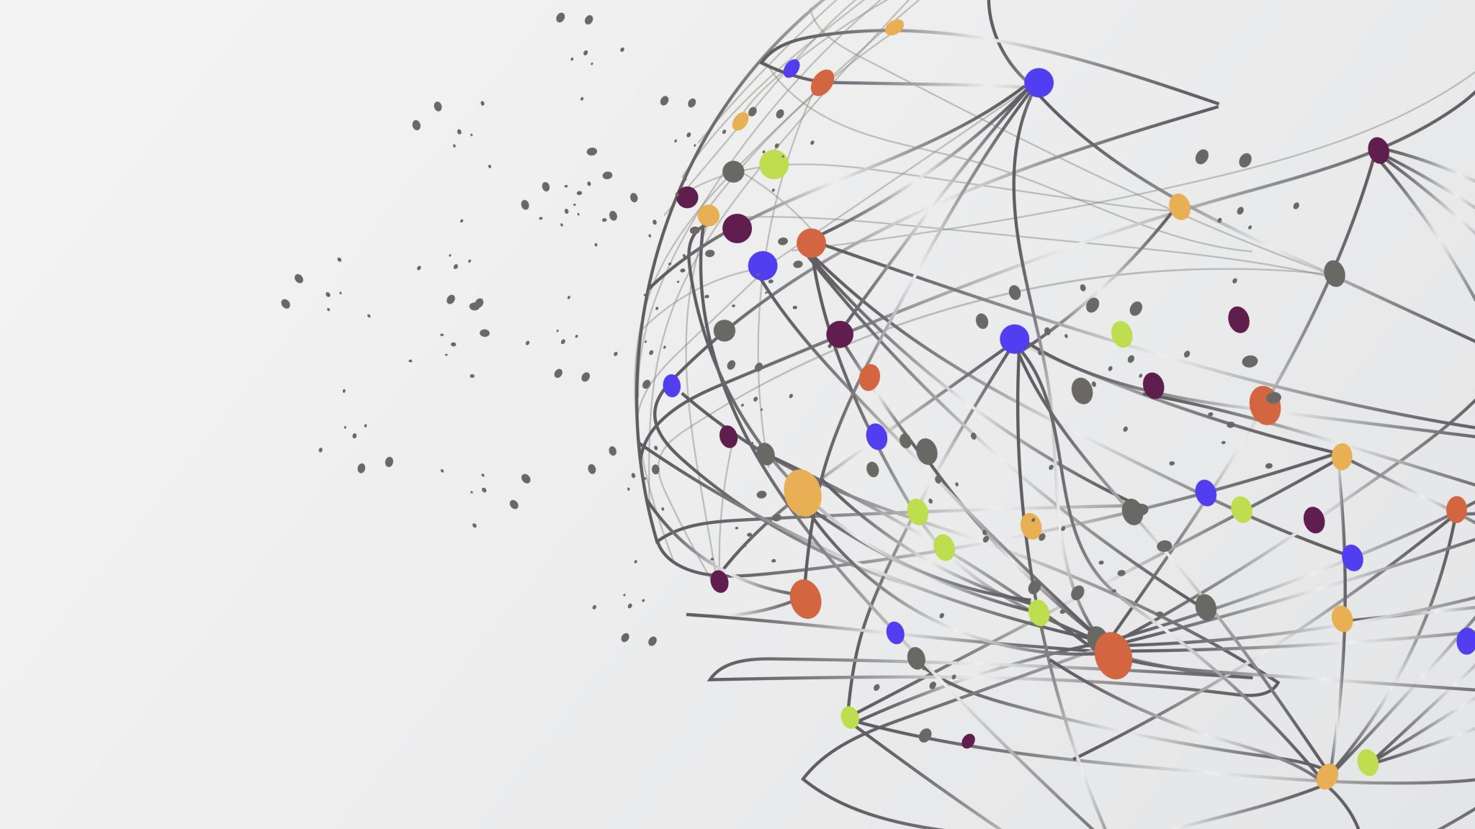
AI in Agriculture
By Ofentse Mapheto & Boikago Mothelo

Slide 2
Agenda
1
2
3
4
Current usage and future Outlook
Development and use cases
Introduction
One AI Technique
5
6
International and Intercultural Context
Conclusion

Slide 3
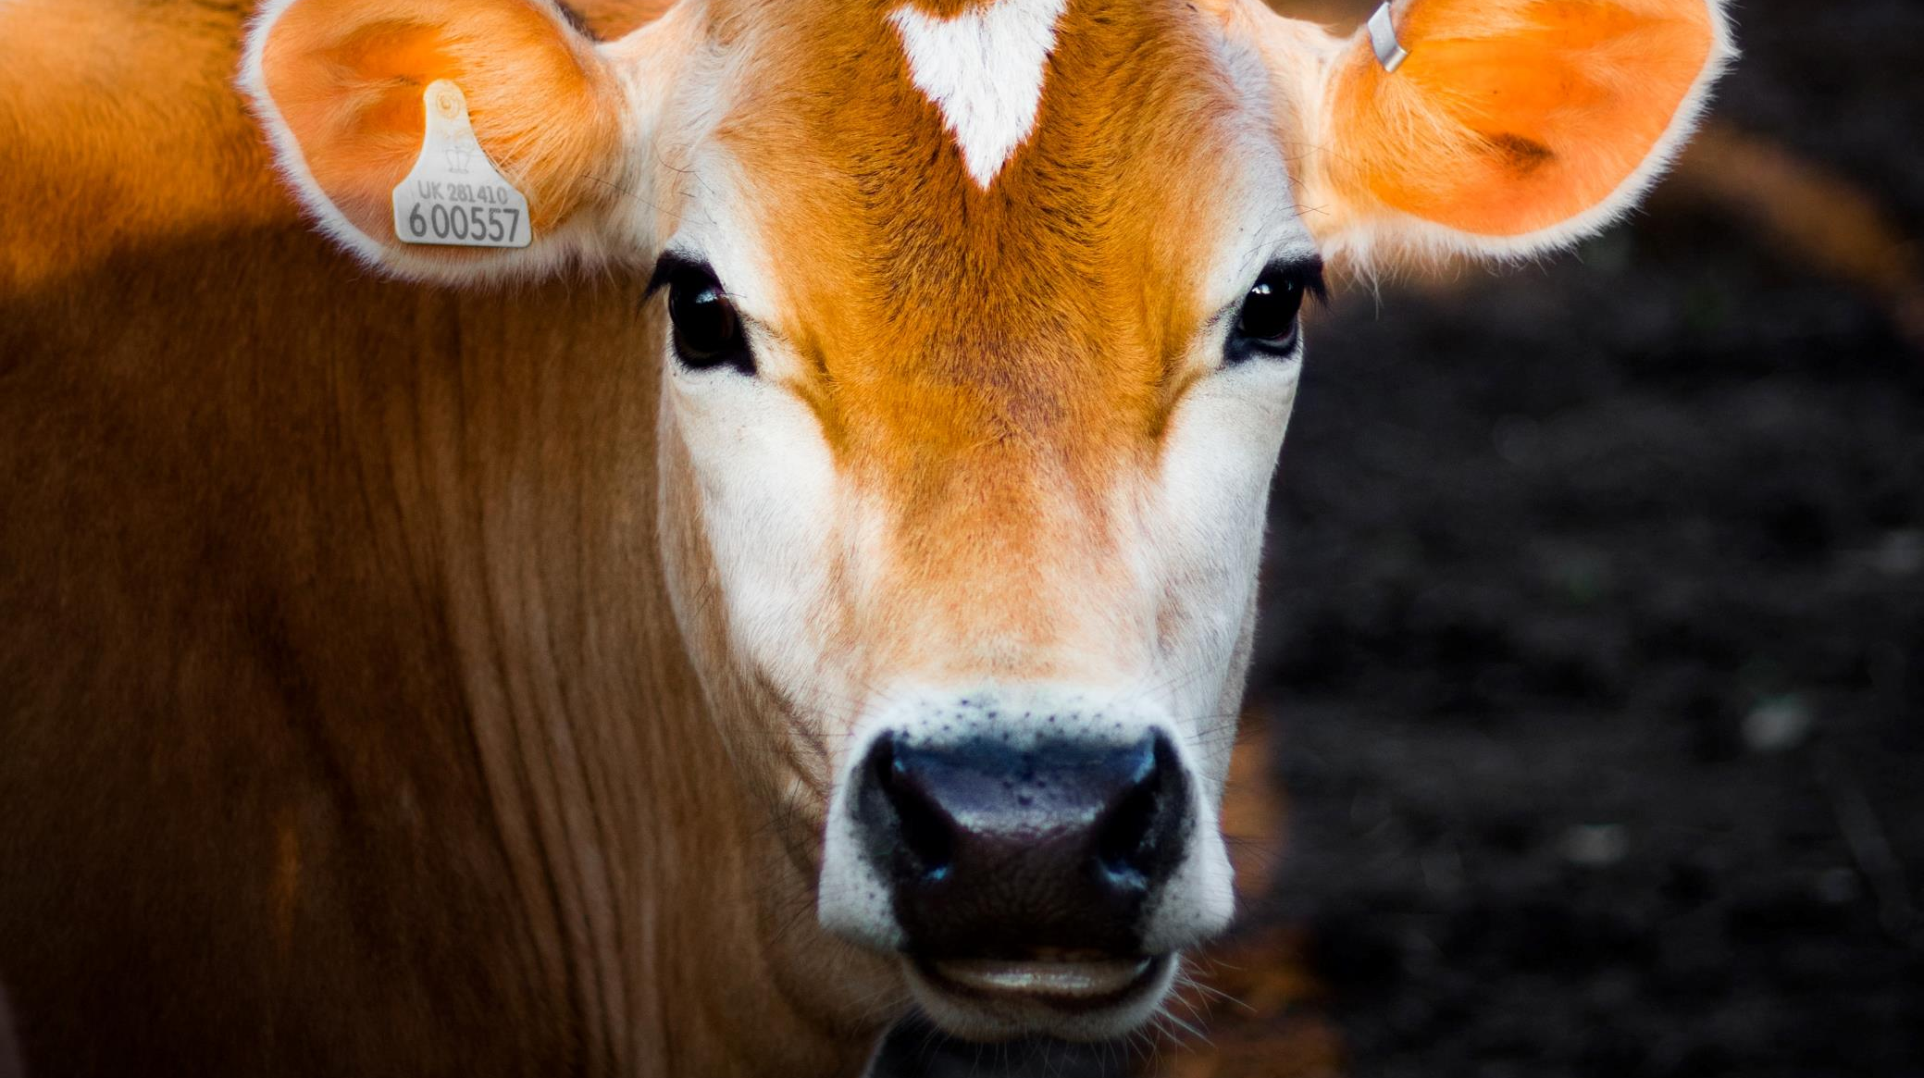
Introduction
Opening Statement

Slide 4
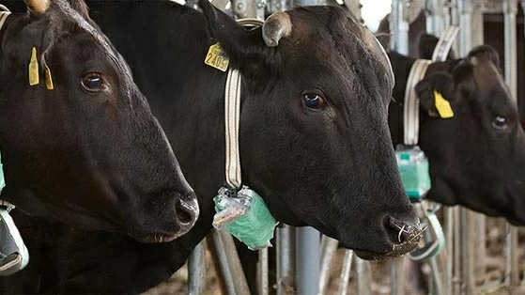
Current usage and Future Outlook
Wearable devices such as collars and ear tags with sensors.
Detects changes in body temp, heart rate, and developed physiological parameters
Devices transmit data to AI system that use machine learning algorithms for detection
Future AI can provide more advances monitoring systems

Slide 5
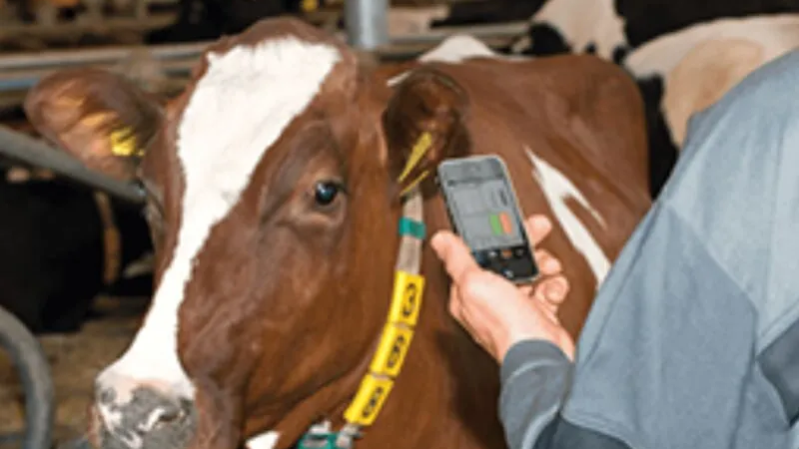
One AI Technique
Machine learning algorithms to analyze large amounts of data from various sources including wearable devices, environmental sensors etc.
Algorithms can use data to identify patterns such as potential health issues such as change in body temp, abnormal behavior etc.

Slide 6
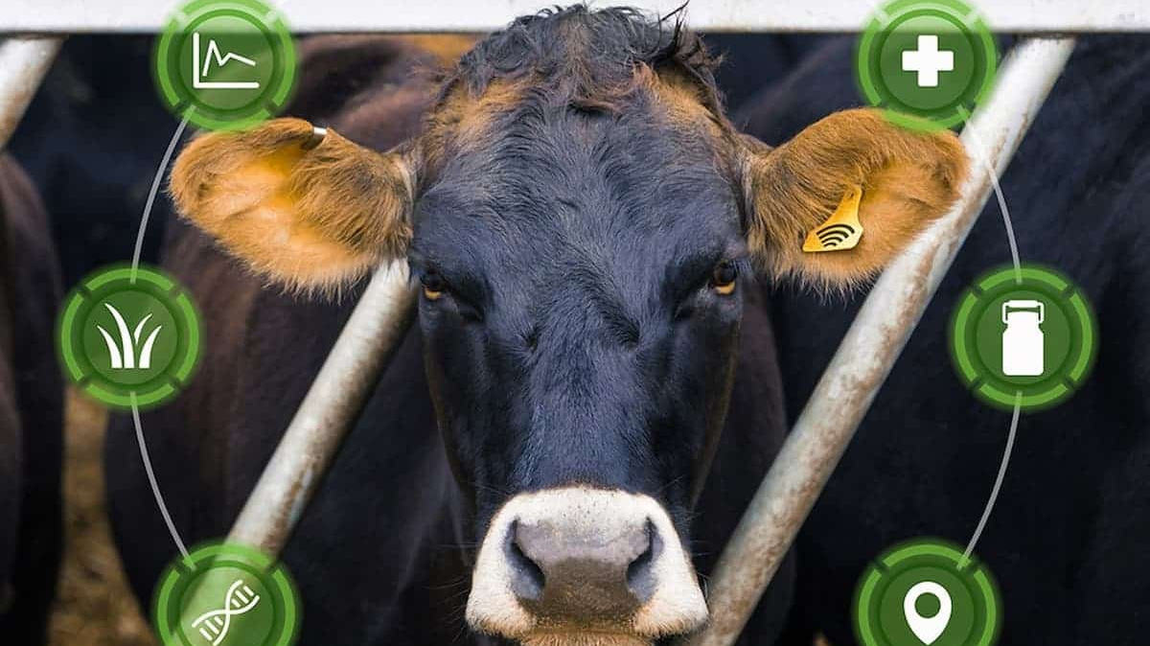
Development and Use Cases
Benefits such as early detection of diseases, reduced antibiotic use and improved animal welfare
Identify and isolate sick animals before infecting other livestock
Ethical concerns such as wearables can raise privacy concerns.

Slide 7
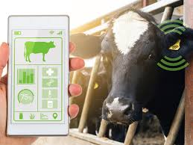
International and Intercultural Context
Perception and acceptance of AI solutions
Data and privacy concerns
Develop AI solutions suitable for different regions and cultures

Slide 8
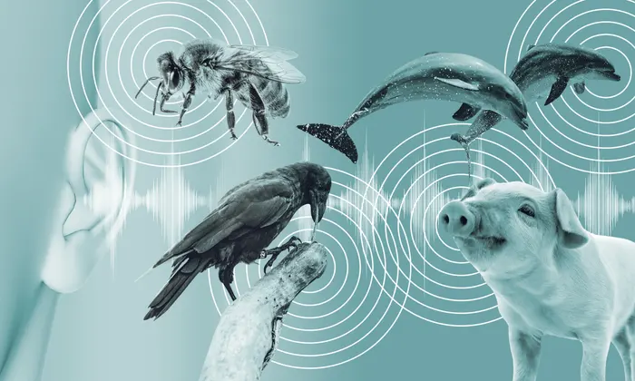
Conclusion
Closing Statement
Audience appreciation

